Slide 1
Exploring Neural Network Architectures for Traffic Flow Forecasting
Presented By:
Aarav Menon
Abhiraman S Nair
Alan Shaiju
Guided By:
Prof. Nimisha Abraham

Slide 2
Contents
Introduction
Literature survey
Problem statement
Existing design
proposed design
architecture
Implementation
Conclusion
References

Slide 3
Introduction
Our project focuses on lack of traffic speed data and proposes a method for traffic speed forecasting based on the multitemporal traffic flow volumes of the previous and later moment states.
It helps traffic management departments improve efficacy of road monitoring and people by providing them better driving routes to arrive safely and smoothly to their destination.

Slide 4
Literature survey

Slide 5
Literature survey
X. Meng et al., "D-LSTM: Short-Term Road Traffic Speed Prediction Model Based on GPS Positioning Data," in IEEE Transactions on Intelligent Transportation Systems, vol. 23, no. 3, pp. 2021-2030, March 2022, doi: 10.1109/TITS.2020.3030546.
Short-term road traffic speed prediction is vital for navigation and traffic supervision.
GPS data-based prediction, enhanced with weather, has shown premise.
D-LSTM model integrates Dynamic Time Warping, adjusting data distribution to historical patterns.
Attention mechanism accounts for varying data effects on predictions.
Outperforms basic models in various scenarios, especially on weekends.

Slide 6
Literature survey
J. Zheng and M. Huang, "Traffic Flow Forecast Through Time Series Analysis Based on Deep Learning," in IEEE Access, vol. 8, pp. 82562-82570, 2020, doi: 10.1109/ACCESS.2020.2990738.
Traffic congestion challenges urban development, prompting the need for Intelligent Traffic Systems (ITS).
ITS relies on accurate traffic flow forecasting, but existing methods struggle with stochastic and lengthy time series.
This paper proposes a deep learning-based traffic flow forecast model using LSTM networks.
Compared with ARIMA and BPNN models, LSTM outperforms in accuracy
Experimentation on real traffic flow data from OpenITS validates LSTM’s superiority.

Slide 7
Literature survey
Peng, H., Bobade, S.U., Cotterell, M.E., Miller, J.A. (2018). Forecasting Traffic Flow: Short Term, Long Term, and When It Rains. In: Chin, F., Chen, C., Khan, L., Lee, K., Zhang, LJ. (eds) Big Data – BigData 2018. BIGDATA 2018. Lecture Notes in Computer Science(), vol 10968. Springer, Cham.
Study examines traffic flow forecasting in Georgia urban areas and freeways using sensor data.
Focuses on longer-term forecasting, evaluating ARIMA, exponential smoothing, and neural networks.
Experiment integrates precipitation data to improve accuracy during rainy weather.
Utilizes dynamic regression models and neural networks for experimentation.

Slide 8
Literature survey
J. Ma, H. Liu, C. Peng and T. Qiu, "Unauthorized Broadcasting Identification: A Deep LSTM Recurrent Learning Approach," in IEEE Transactions on Instrumentation and Measurement, vol. 69, no. 9, pp. 5981-5983, Sept. 2020, doi: 10.1109/TIM.2020.3008988.
Radio broadcasting is vital but faces challenges from illegal stations exploiting software-defined ratio.
Unauthorized broadcasts disrupt licensed frequencies, impacting emergency services and air traffic control.
Automatic detection of illegal broadcasting is complex in electromagnetic environments.
Proposed solution: LSTM RNN-based identification system using LabVIEW and USRP 2930s.
Achieves 99.83% accuracy in identifying unauthorized broadcasts at 107.8MHz.

Slide 9
Literature survey
Felix Rempe, Philipp Franeck, Klaus Bogenberger, On the estimation of traffic speeds with Deep Convolutional Neural Networks given probe data, Transportation Research Part C: Emerging Technologies, Volume 134, 2022, 103448, ISSN 0968-090X
Investigates Deep Convolutional Neural Network for traffic speed estimation from sparse freeway data.
Proposes a methodology for training on variable-sized domains, outperforms traditional methods.
Utilizes deep CNN approach and data augmentation for improved performance.
Evaluation shows superior accuracy and general applicability compared to traditional methods.
Suggests potential advancements in less-data dependent learning methods like PINN.

Slide 10
Research gap
The current model utilizes data from a single detector to predict values within a certain radius.
Selection of very less number of parameters.
Usage of only 5 models.

Slide 11
Problem statement
Creating an innovative deep learning framework using multi-temporal traffic flow volume data to overcome the limitation of sparse traffic speed data, with the goal of revolutionizing urban traffic management by enhancing decision-making optimizing road monitoring systems, and guiding drivers towards safer and more efficient routes.

Slide 12
Research objectives
To devise an innovative deep learning framework utilizing multi-temporal traffic flow volume data to mitigate challenges arising from limited traffic speed data.
The objective is to advance urban traffic management by enhancing decision-making processes, optimizing road monitoring systems, and facilitating drivers in selecting safer and more efficient routes.

Slide 13
Existing design

Slide 14
The current approach comprises two primary components: traffic flow pattern extraction and the introduction of various forecasting models.
The various forecasting models that are used are:
LSTM: Excels at capturing long-term dependencies
BP: Optimizes parameters through neural network training
CART: Provides a decision tree-based approach
KNN: Offers non-parametric solutions
SVR: tailored for regression analysis

Slide 15
Proposed design

Slide 16
The models which we have added are the following:
GRU: Renowned for its ability to capture temporal dependencies in sequential data
SAE: SAE are employed for unsupervised feature learning and hierarchical representation extraction
Random Forest: A robust ensemble learning method utilizing multiple decision tress to improve prediction accuracy

Slide 17
architecture
Preprocess dataset
The model which provides most accurate result is selected
Preprocessing dataset
Select the best model
Traffic flow pattern extraction
Using models in proposed design and compare them.
Using models mentioned in existing design
Introduction of various forecasting models

Slide 18
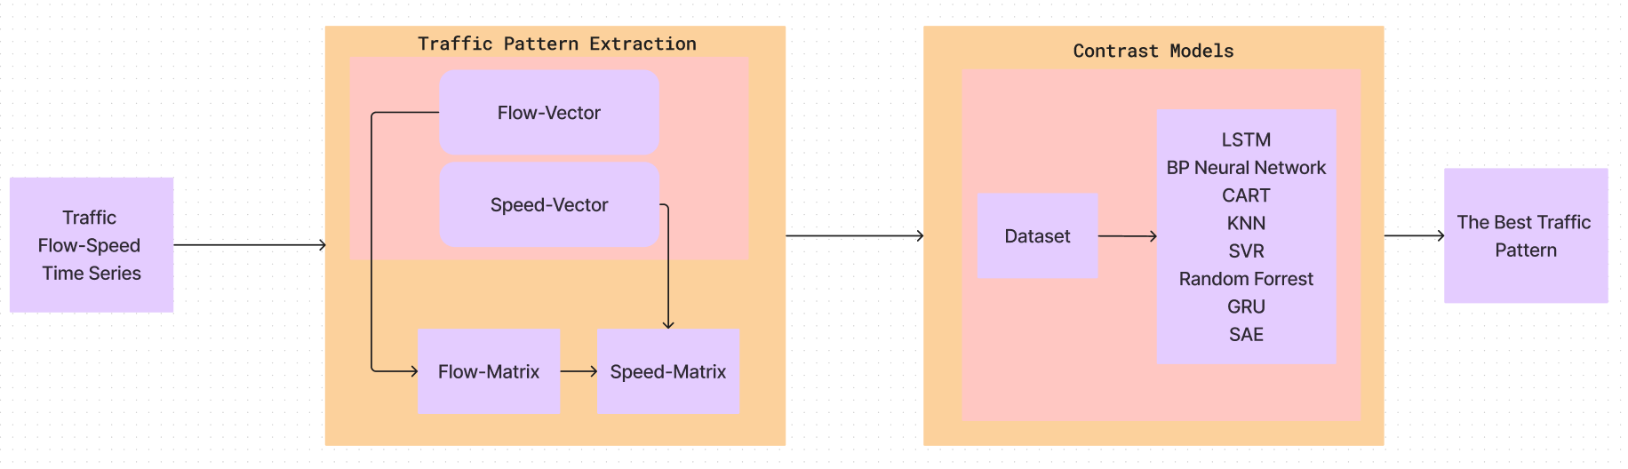
architecture

Slide 19
Implementation

Slide 20
Data preprocessing
DATASET WITH SPEED
Initial Data Check Identify and handle missing values Explore data distribution
Normalization Utilize StandardScalar for feature normalization (e.g., Flow, Occ etc.) Ensure uniform feature scaling
Feature selection Remove irrelevant columns (e.g., LANE_NO, TIME etc.) Focus on relevant attributes for analysis

Slide 21
Data preprocessing
DATASET WITHOUT SPEED
Categorical Encoding Use Label encoder to encode categorical variable (e.g., weather_type) Convert categorical values into numerical representations
Normalization Apply StandardScalar to scale numerical attributes (e.g., last_1_hour_traffic etc.) Ensure consistent scaling for all features
Feature selection Remove irrelevant columns (e.g., weather_description) Remove biased attributes Focus on relevant attributes for analysis
Filtering Filtering entries with values below a certain threshold (e.g., entry_counts < 100 are filtered out)

Slide 22
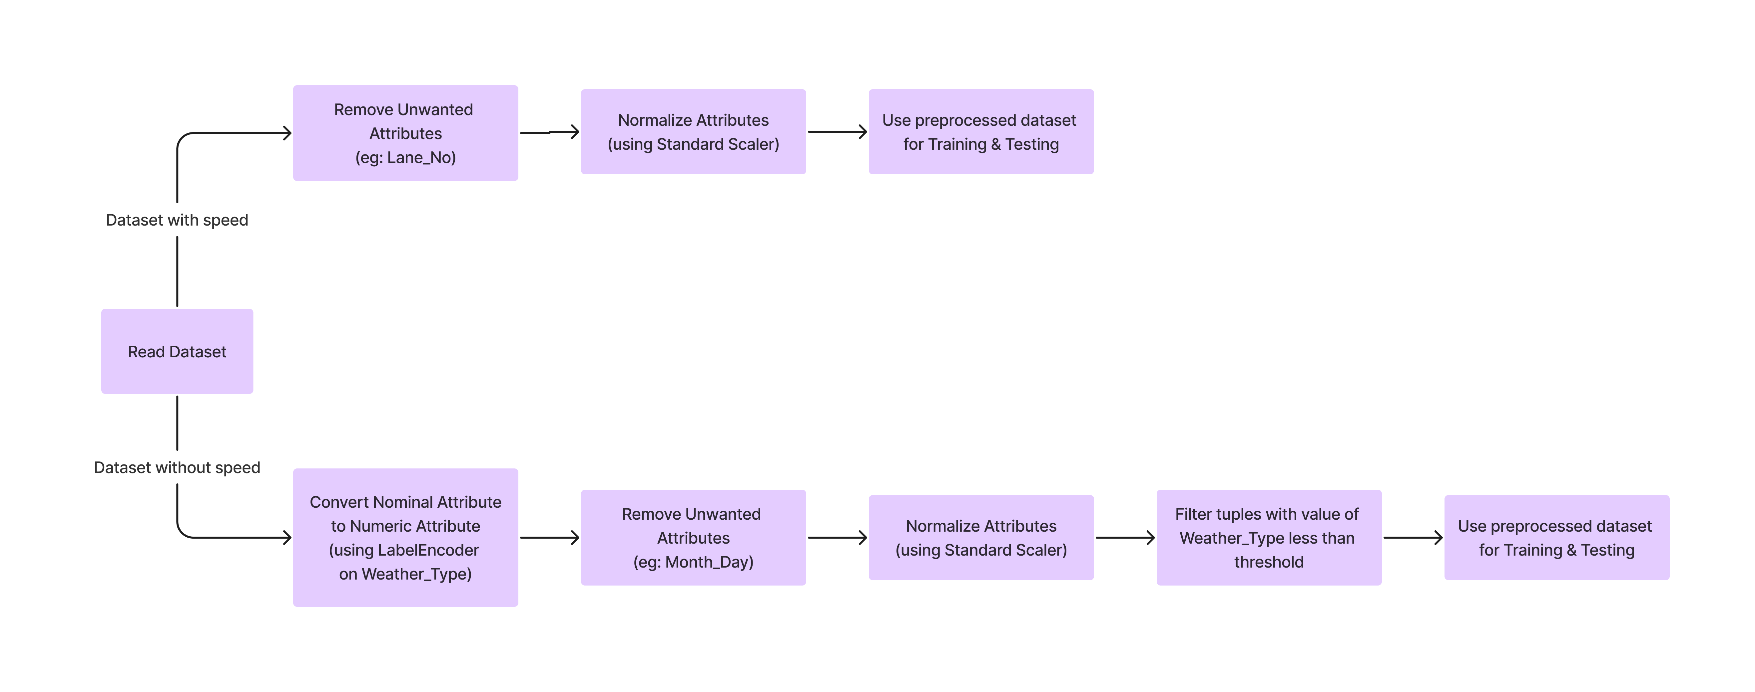

Slide 23
Models used in existing design
CLASSIFICATION AND REGRESSION TREES (CART)
CART (Classification and Regression Trees) are used for classification and regression tasks.
They recursively partition the input space based on feature values.
CART aims to minimize impurity or variance within each subset.
Binary Trees are formed with decision nodes representing feature-based decisions and leaf nodes for predictions.

Slide 24
Models used in existing design
K-NEAREST NEIGHBOURS (KNN)
KNN (K-Nearest Neighbours) is a non-parametric algorithm for classification and regression.
It stores all training data points in memory and classifies new points based on majority class or average of nearest neighbours.
“k” denotes the number of nearest neighbours considered for predictions.
The algorithm’s performance relies on choosing the appropriate “k” and distance metric for similarity measurement.

Slide 25
Models used in existing design
LONG SHORT-TERM MEMORY (LSTM)
LSTM (Long Short-Term Memory) is a recurrent neural network tailored for sequential data processing.
It tackles the vanishing gradient problem by incorporating gates to manage information flow.
Gates control input, output, and memory retention, allowing the network to capture long-term dependencies.
LSTMs excel in tasks like speech recognition, language translation, and time series prediction due to their capacity to model sequential patterns and overcome RNN limitations.

Slide 26
Models used in existing design
BACKPROPAGATION (BP)
Backpropagation (BP) is a key algorithm for training neural networks.
It iteratively updates network parameters to minimize the error between predicted and actual outputs.
This invokes computing gradients of the loss function with respect to each parameter and adjusting them to reduce loss.
Iteration continues until model converges to an acceptable solution

Slide 27
Models used in existing design
SUPPORT VECTOR REGRESSION (SVR)
Support Vector Regression is a supervised algorithm for regression tasks.
It maps input data points into a high-dimensional feature space.
SVR finds the optimal hyperplane that maximizes the margin between training data points and the hyperplane.
Its goal is to minimize margin violations while capturing underlying patterns in the data.
SVR effectively handles non-linearity using kernel functions to transform data into higher dimensional space.

Slide 28
Models used in our design
GATED RECURRENT UNIT (GRU)
Gated Recurrent Unit is a type of recurrent neural network architecture.
It addresses limitations of traditional RNNs like vanishing and exploding gradients.
Similar to LSTM but with a simpler architecture and fewer parameters.
Combines memory cell and hidden state into a single vector
Uses two gates, the update gate and the reset gate, to control information flow.
GRU is computationally more efficient compared to LSTM.

Slide 29
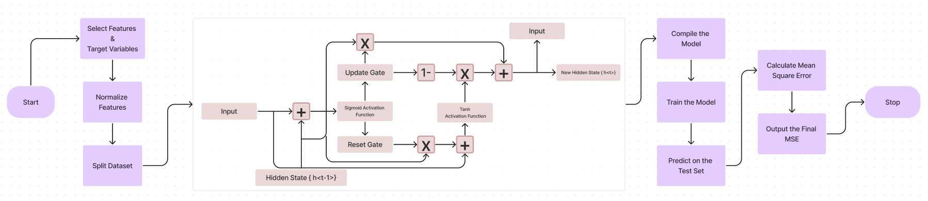
Models used in our design
GATED RECURRENT UNIT (GRU)

Slide 30
Models used in our design
STACKED AUTOENCODER (SAE)
Stacked Autoencoder is an artificial neural network for unsupervised learning tasks like feature learning and dimensionality reduction.
Comprises multiple layers of autoencoder units.
Each layer learns to reconstruct input data from the previous layer.
Trained layer by layer in an unsupervised manner.
Learns increasingly abstract representations of input data.

Slide 31
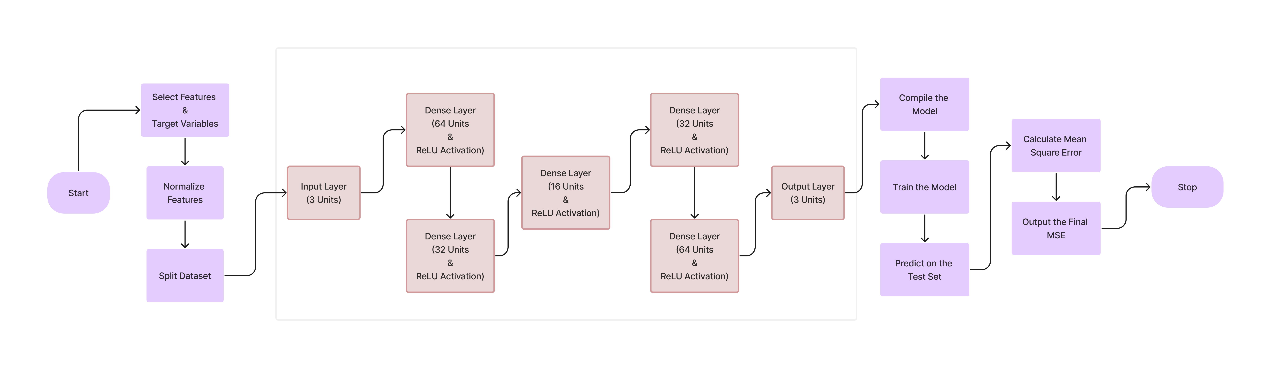
Models used in our design
STACKED AUTOENCODER (SAE)

Slide 32
Models used in our design
RANDOM FOREST (RF)
Random Forest is an ensemble learning algorithm for classification and regression tasks.
Constructs multiple decision trees during training.
Outputs the mode or average of predictions from individual trees.
Each decision tree is trained on a random subset of the training data and features.
Helps to reduce overfitting and improve generalization performance

Slide 33
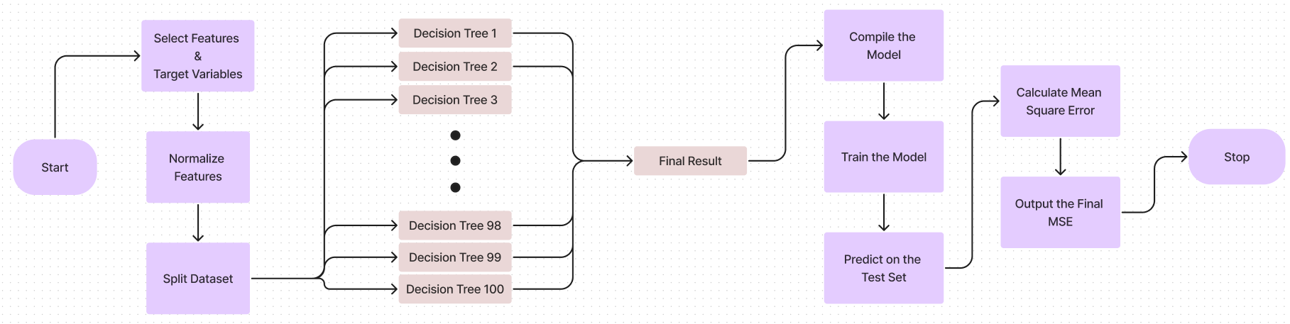
Models used in our design
RANDOM FOREST (RF)

Slide 34
result

Slide 35
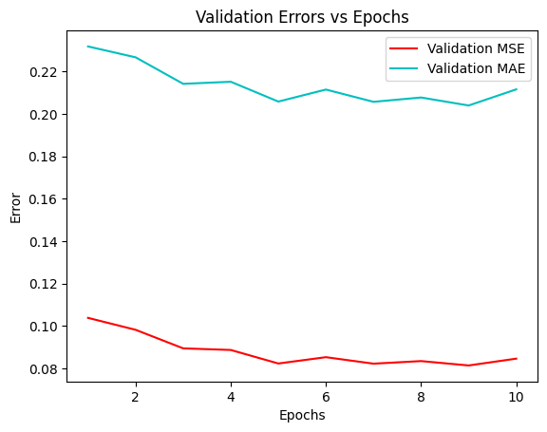
GRU with speed

Slide 36
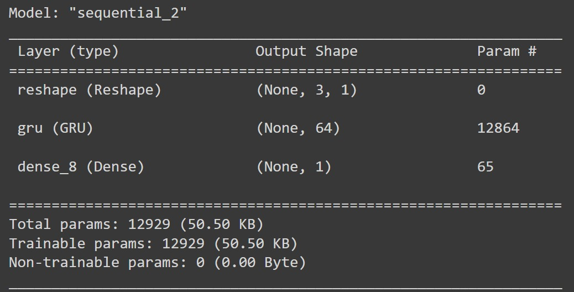

GRU with speed

Slide 37
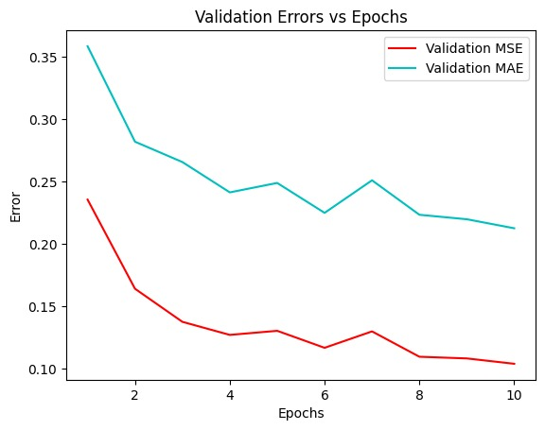
GRU without speed

Slide 38
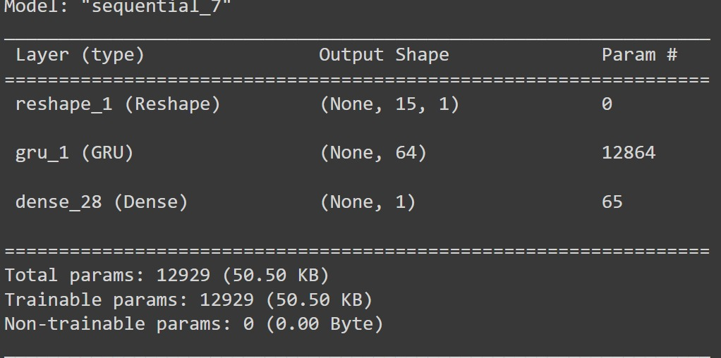
GRU without speed

Slide 39
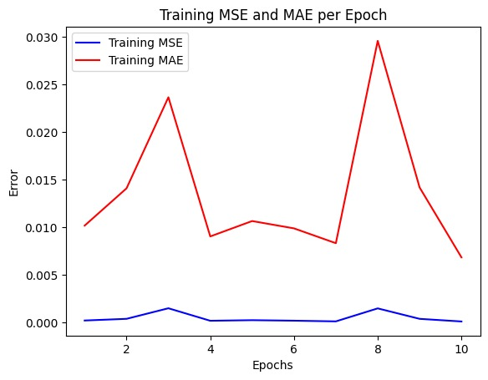
SAE with speed

Slide 40
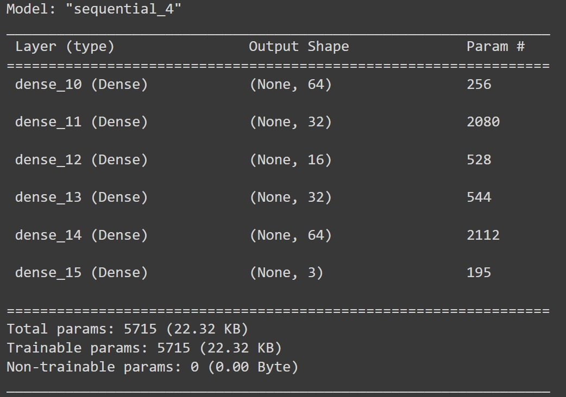

SAE with speed

Slide 41
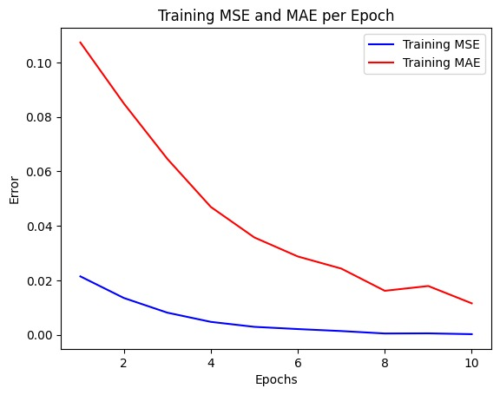
SAE without speed

Slide 42
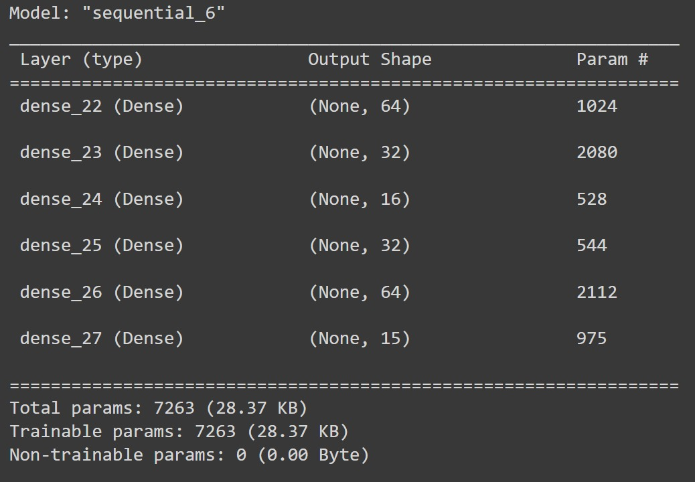
SAE without speed

Slide 43
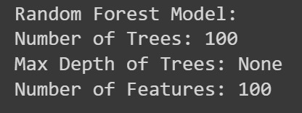

RANDOM FOREST with speed

Slide 44
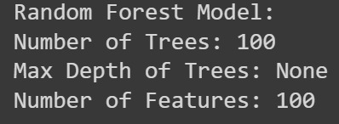

RANDOM FOREST without speed

Slide 45
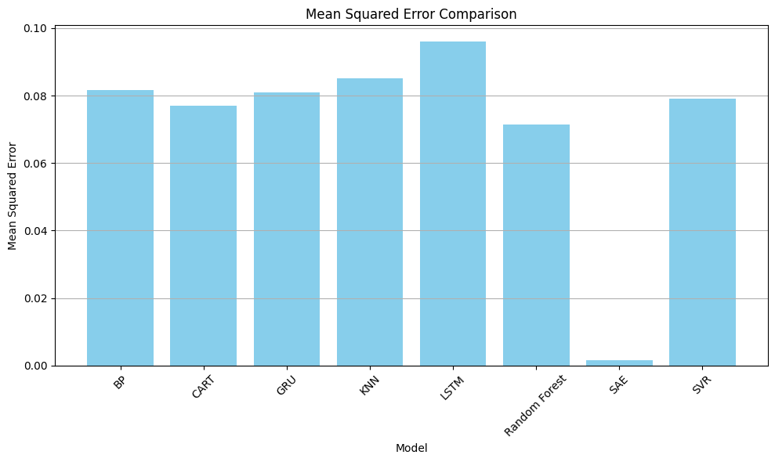

Slide 46
Mean Squared Error comparison
 | SVR | SAE | RF | LSTM | KNN | GRU | CART | BP
With speed | 0.078972 | 8.70x10^-5 | 0.071418 | 0.095541 | 0.085356 | 0.079245 | 0.076524 | 0.084271
Without speed | 0.094488 | 0.020091 | 0.065463 | 0.094009 | 0.184939 | 0.098042 | 0.131491 | 0.117443

Slide 47
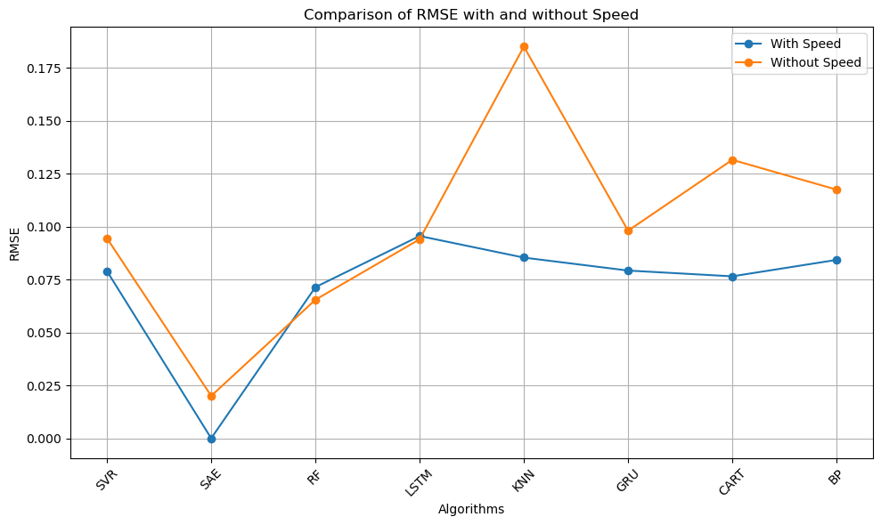

Slide 48
Conclusion
Conclusively, this project conducted a comprehensive investigation into the effectiveness of multiple neural networking architectures in the domain of traffic flow forecasting.
Our meticulous examination unveiled a clear standout: the SAE architecture exhibited the most promising performance among its counterparts.

Slide 49
REFERENCES

Slide 50
REFERENCES
Y. Gao, C. Zhou, J. Rong, Y. Wang and S. Liu, "Short-Term Traffic Speed Forecasting Using a Deep Learning Method Based on Multitemporal Traffic Flow Volume," in IEEE Access, vol. 10, pp. 82384-82395, 2022
Y. Li and S. Zhou, "A New Instantaneous Wavelet Bicoherence for Local Fault Detection of Rotating Machinery," in IEEE Transactions on Instrumentation and Measurement, vol. 69, no. 1, pp. 135-143, Jan. 2020, doi: 10.1109/TIM.2019.2895483.
Ke, R., Li, W., Cui, Z., & Wang, Y. (2020). Two-Stream Multi-Channel Convolutional Neural Network for Multi-Lane Traffic Speed Prediction Considering Traffic Volume Impact. Transportation Research Record, 2674(4), 459-470. https://doi.org/10.1177/0361198120911052
4.
Emmanuel Cabrera-Navarrete, Gerardo Ronquillo-Jarillo, Anatoly Markov, Wavelet analysis for spectral inversion of seismic reflection data, Journal of Applied Geophysics, Volume 177, 2020, 104034, ISSN 0926-9851, https://doi.org/10.1016/j.jappgeo.2020.104034.
H. Zeynal, Z. Zakaria and A. Kor, "Traffic Flow Prediction Using SVR-Ant Colony Optimization: A Practical Case of Tehran Highway," 2021 IEEE International Conference in Power Engineering Application (ICPEA), Malaysia, 2021, pp. 155-160, doi: 10.1109/ICPEA51500.2021.9417845
5.

Slide 51
REFERENCES
6.
Errachid, M., Essanhaji, A. & Messaoudi, A. RMVPIA: a new algorithm for computing the Lagrange multivariate polynomial interpolation. Numer Algor 84, 1507–1534 (2020). https://doi.org/10.1007/s11075-020-00907-8
K. Turgut and A. K. Hocaoglu, ‘‘Comparison of Kalman filter and converted measurements Kalman filter for interacting multiple model,’’ in Proc. 26th Signal Process. Commun. Appl. Conf., 2018, pp. 1–4,
Emmanuel Cabrera-Navarrete, Gerardo Ronquillo-Jarillo, Anatoly Markov, Wavelet analysis for spectral inversion of seismic reflection data, Journal of Applied Geophysics, Volume 177, 2020, 104034
9.
Zhuoxi Yu, Lu Qin, Yunjing Chen, Milan Deepak Parmar, Stock price forecasting based on LLE-BP neural network model, Physica A: Statistical Mechanics and its Applications, Volume 553, 2020, 124197
R. Tang and X. Zhang, "CART Decision Tree Combined with Boruta Feature Selection for Medical Data Classification," 2020 5th IEEE International Conference on Big Data Analytics (ICBDA), Xiamen, China, 2020, pp. 80-84
7.
10.
8.

